Slide 1
Z1146 - ENTREPRENEURSHIP II
SESSION VII
REVENUE STREAMS & COST STRUCTURE

Slide 2
Learning Objectives
LO 1 : Creating an innovative business model

Slide 3
Revenue Streams

Slide 4

Revenue Streams
The Revenue Streams Building Block represents
the cash a company generates from each Customer
Segment

Slide 5
Types of Revenue Streams
Transaction revenues resulting from one-time customer payments
Recurring revenues resulting from ongoing payments to either deliver a Value Proposition to customers or provide post-purchase customer support

Slide 6
Several Ways to Generate Revenue Streams
Asset sale
Usage fee
Subscription fee
Lending / Renting / Leasing
Licensing
Brokerage fee
Advertising

Slide 7
Cost Structure

Slide 8

Cost Structure
The Cost Structure describes all costs incurred to
operate a business model

Slide 9
Classes of Business Model Cost Structure
Cost-Driven
Value-Driven
focus on minimizing costs wherever possible
focus on value creation
e.g.: Citilink
e.g.: Garuda Indonesia

Slide 10
Cost Structure Characteristics
Fixed Costs
Variable Costs
Economies of Scale
Economies of Scope

Slide 11
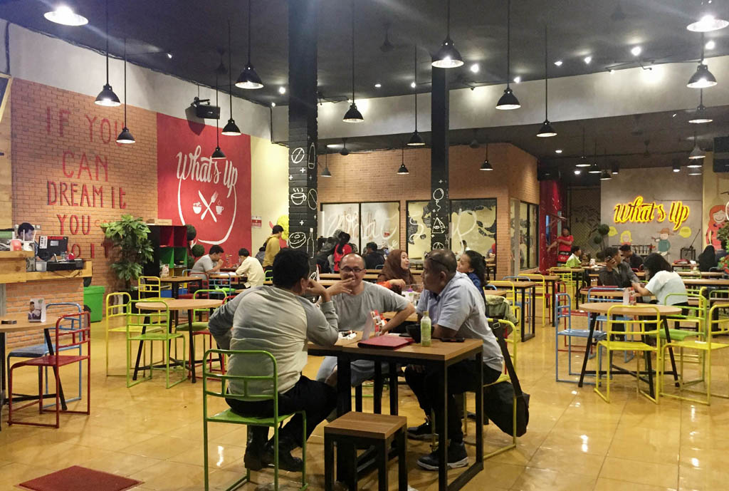
Case
What’s Up Cafe
http://www.whatsupcafe.co.id/img/chapters/whatsup_meruya.jpg
What are the revenue streams and cost structure of What’s Up Cafe?

Slide 12
References
Osterwalder, A., & Pigneur, Y. (2010). Business model generation: a handbook for visionaries, game changers, and challengers. John Wiley & Sons.

